Slide 1


Exploring Sales Insights with tableau
Isaac Afedia N01513981

Slide 2

Project Objectives:
Our primary objectives include:
Uncovering trends, patterns, and correlations in sales data.
Visualizing data using Tableau to provide clear and actionable insights.
Identifying opportunities for optimizing sales strategies and improving customer experiences.
Dataset Source and Key Features:
The dataset we'll be working with has been provided by the sales teams
Key features of the dataset are:
It encompasses a wide range of sales transactions.
Contains essential details such as Invoice ID, Branch, Product Line, Quantity, Total, Date, Payment, and more.
Offers a comprehensive view of our sales performance across different dimensions

Slide 3
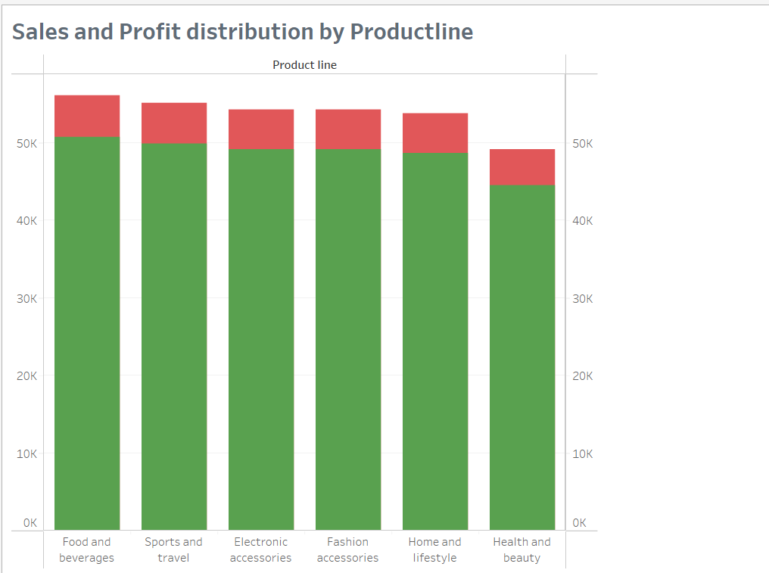
Sales and Profit Distribution by Product Line
Display the bar chart showcasing the distribution of sales and profit across different product lines.
The x-axis represents the product lines, while the y-axis represents the sales and profit values.
Insights:
Understanding which product lines contribute the most to sales and profit is crucial for strategic decision-making.
Identifying top-performing product lines helps allocate resources effectively and focus on high-impact areas.

Slide 4
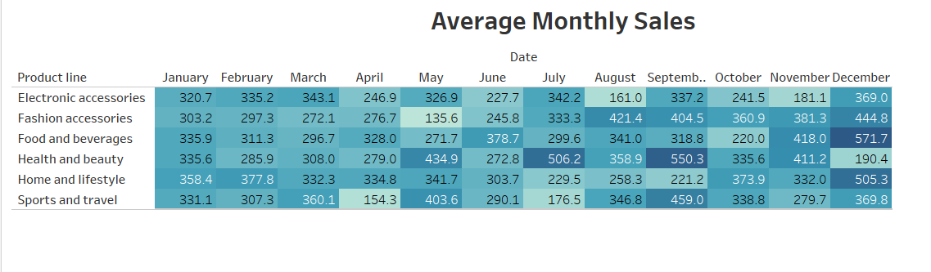
Average Monthly Sales of Each Product Line
Showcase the highlight table presenting average monthly sales figures for each product line.
The table displays the product lines along with their corresponding average sales values for each month.
Significance of Monitoring Average Sales Trends:
Monitoring average sales trends is essential for identifying growth opportunities and potential areas for improvement.
It helps in understanding which product lines consistently perform well and which ones might need attention.
Observations and Patterns:
Analyzing the average sales figures over time may reveal seasonal trends or fluctuations.

Slide 5
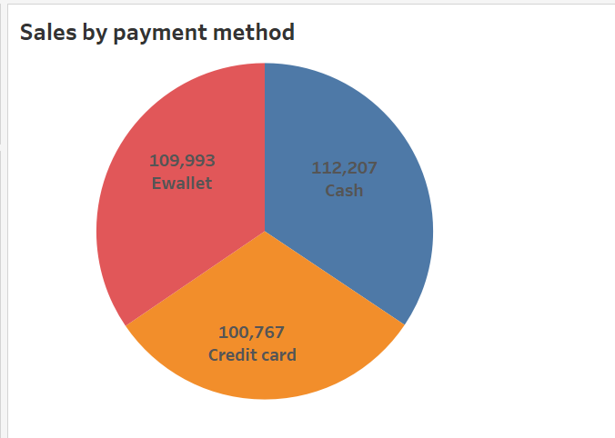
Total Sales by Payment Method - Pie Chart
Each payment method is represented by a segment, and the size of the segment corresponds to its proportion of total sales.
Notice that payments are shared across all payment method almost equally.
Cash method is very popular amongst costumers so a secure way to deal with the cash should be provided.

Slide 6
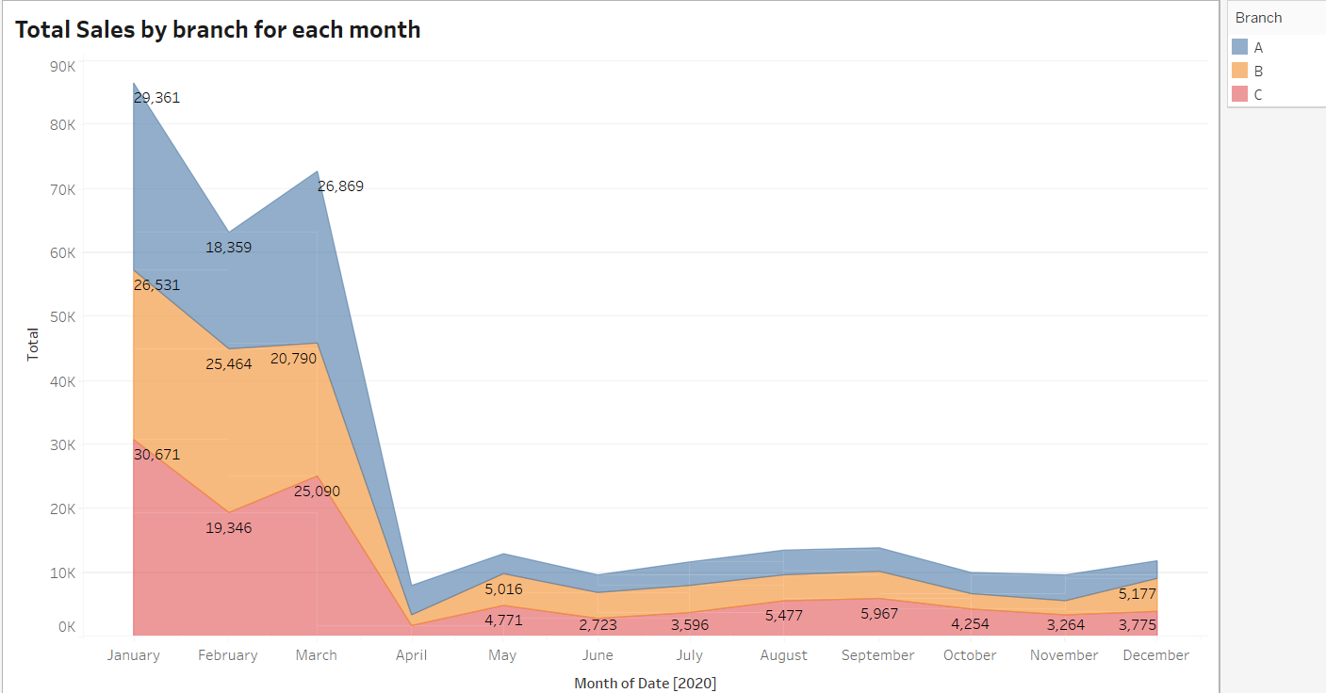
Total Sales by Branch for Each Month on an Area Chart
Each branch is represented by a colored area, and the x-axis represents the months.
Significance of Branch-Wise Sales:
Analyzing sales by branch helps identify which locations contribute the most to overall revenue.
It allows for targeted strategies and resource allocation to optimize performance.
Growth Trends and Areas of Improvement:
Identify any growth trends, such as branches consistently outperforming others.

Slide 7
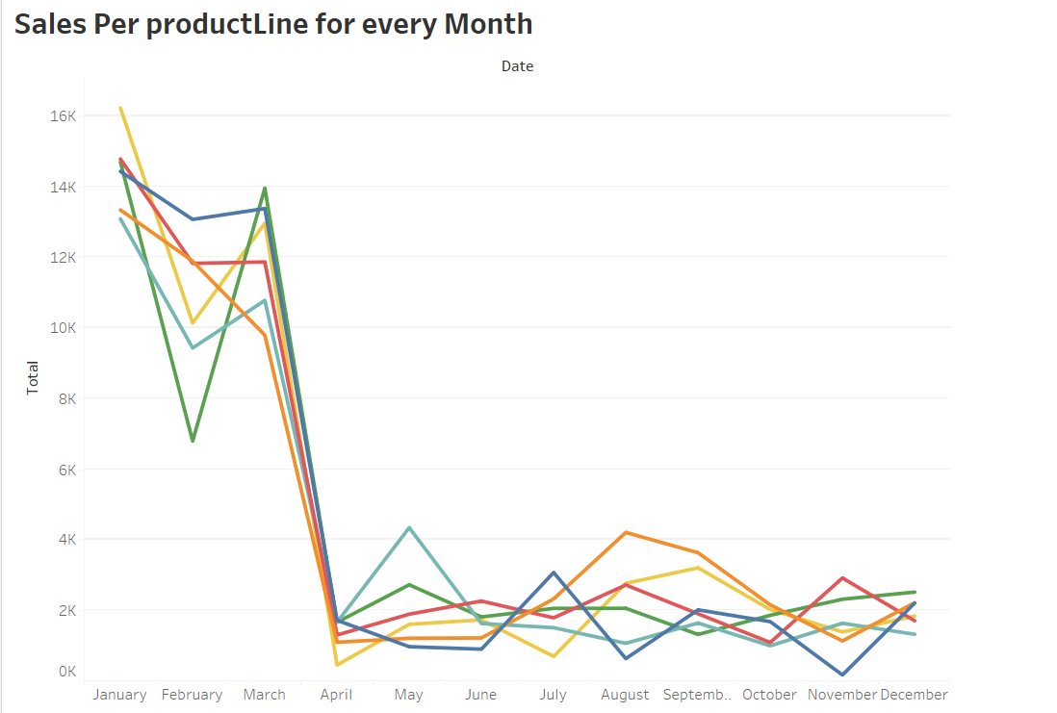
Monthly Sales per Product Line - Line Chart
Show the line chart presenting monthly sales figures for each product line.
Each product line is represented by a line on the chart, with the x-axis representing the months.
Importance of Tracking Monthly Sales Trends:
Tracking sales trends per product line helps allocate resources and inventory effectively.
It assists in identifying which lines have consistent demand and which may need adjustments.

Slide 8

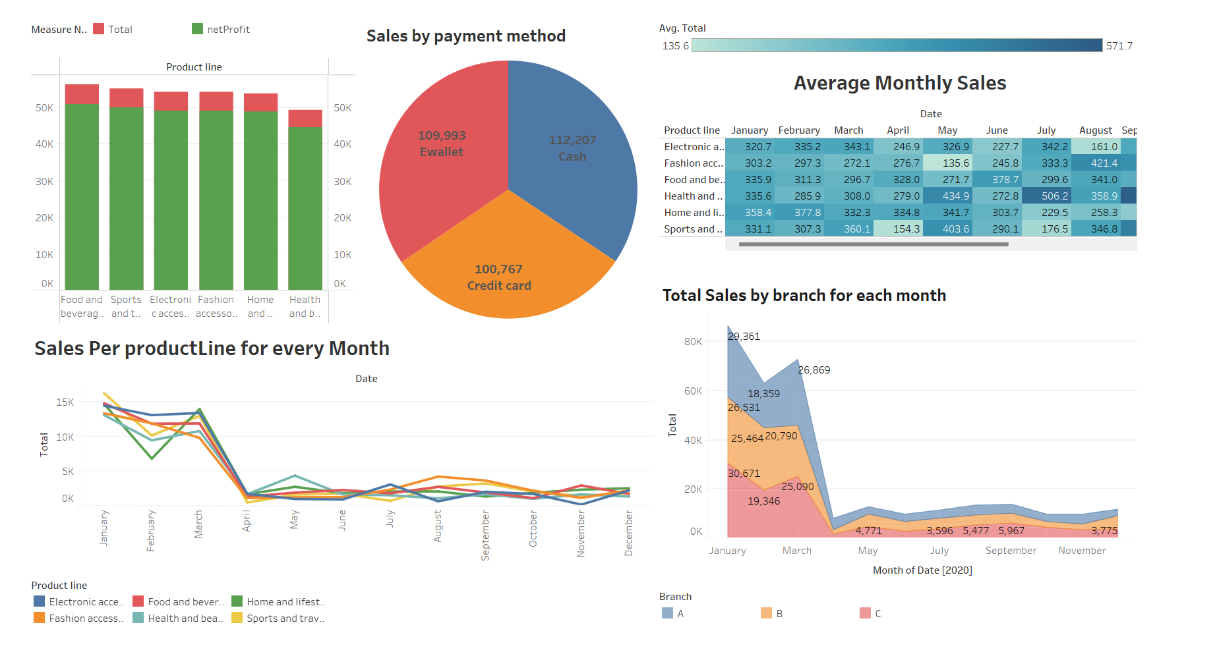
Dashboard Overview

Slide 9
Conclusion and Insights:
The “Food and Beverage" and “Sports" product lines consistently drive the highest sales and profit, suggesting a strong customer preference for these categories.
Observing a higher average sales in certain months could be attributed to promotional activities or seasonal factors, indicating the potential for targeted marketing efforts during those times.
The dominance of the “Cash" payment method indicates its popularity among customers; optimizing the credit card experience could further improve customer satisfaction.
"Branch C" consistently outperforms the others in terms of sales, suggesting potential strategies for sharing best practices across branches.
Investigations into events that happened between March and April to understand what drove down sales and find was to curtail them.

Slide 10

THANK YOU

